Slide 1
With a lot of examples and a lot of tools for analysing business and find solutions

Slide 2
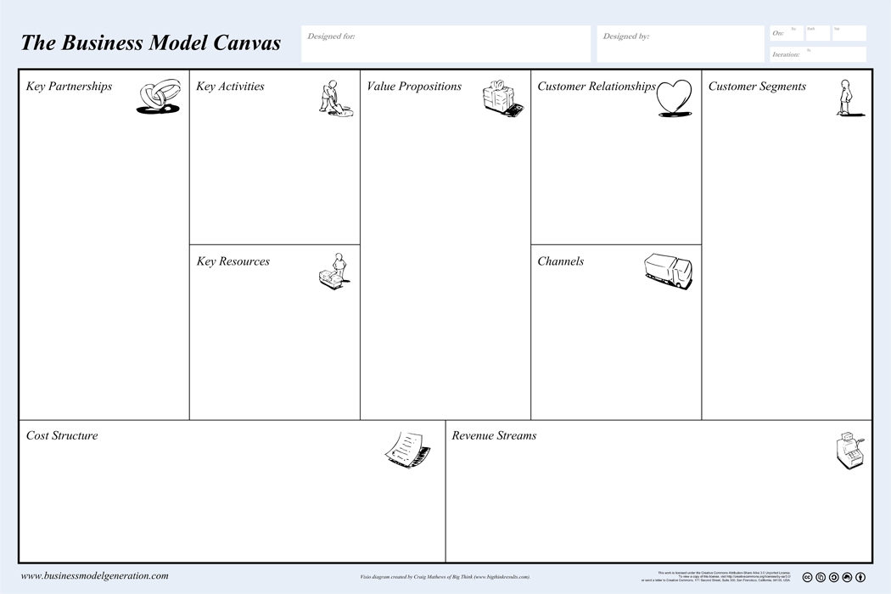
Page 14 - 44
Infrastructure
Offering
Customers
Finances

Slide 3
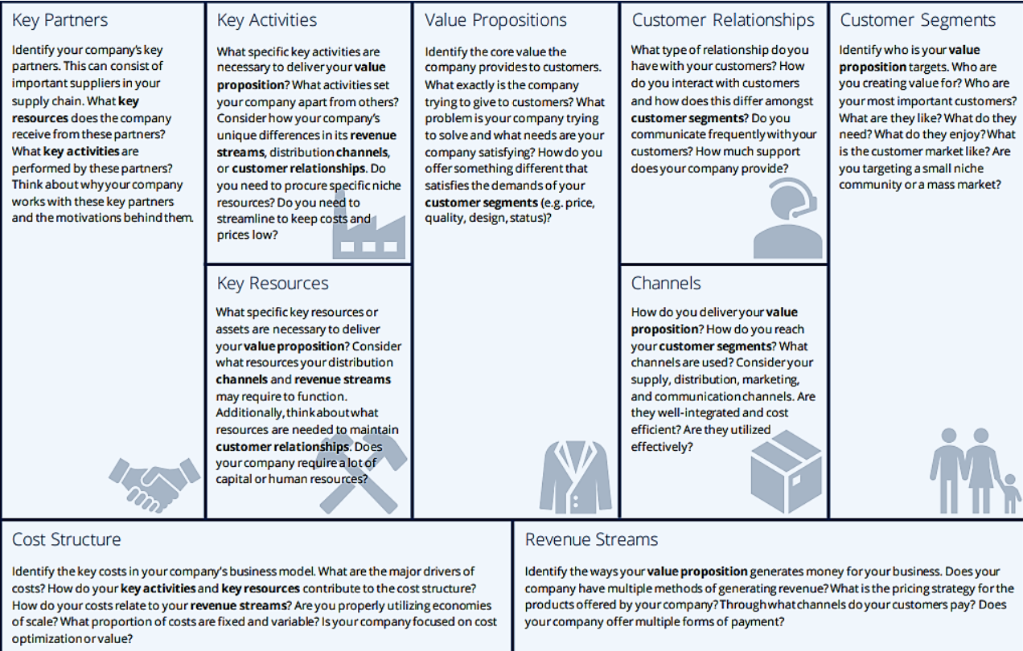
Offering
Infrastructure
Customers
Finances

Slide 4
Questions to be Answered:
Page 14 - 44
What Key Activities do our Value Propositions require? Our Distribution Channels? Customer Relationships? Revenue streams?
What type of relationship does each of our Cust-omer Segments expect us to establish and main-tain with them?
Which ones have we established? How costly are they? How are they integrated with the rest of our business model?
Who are our Key Part-ners? Who are our key suppliers? Which Key Resources are we acqui-ring from partners?
Which Key Activities do partners perform?
What value do we deliver to the customer?
Which one of our cust-omer’s problems are we helping to solve?
Which customer needs are we satisfying?
What bundles of products and services are we offering to each Customer Segment?
For whom are we creating value?
Who are our most important customers?
What Key Resources
do our Value Proposi-tions require? What Key Resources do our Dis-tribution Channels re-quire? What Key Resour-ces do our Customer Re-lationships require?
What Key Resources do our Revenue Streams re-quire?
Through which
Channels do our Customer Segments want to be reached? How are we reaching them now? How are our Channels integrated? Which ones work best? Which ones are most cost-efficient? How are we integrating them with cust-omer routines?
What are the most important costs inherent in our business
model?
Which Key Resources are most expensive?
Which Key Activities are most expensive?
For what value are our customers really willing to pay?
For what do they currently pay?
How are they currently paying?
How would they prefer to pay?
How much does each Revenue Stream contribute to overall
revenues?

Slide 5
Page 200 - 209

Slide 9
Gross domestic products (GDP) is a monetary measure of the market value of all the final goods and services produced in a specific time period, often annually.

Slide 10
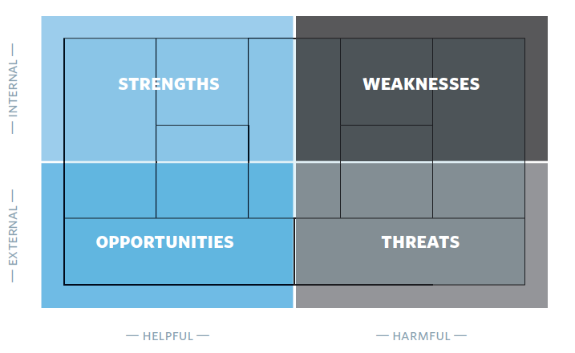
Detailed swot assessment of each building block

Slide 11
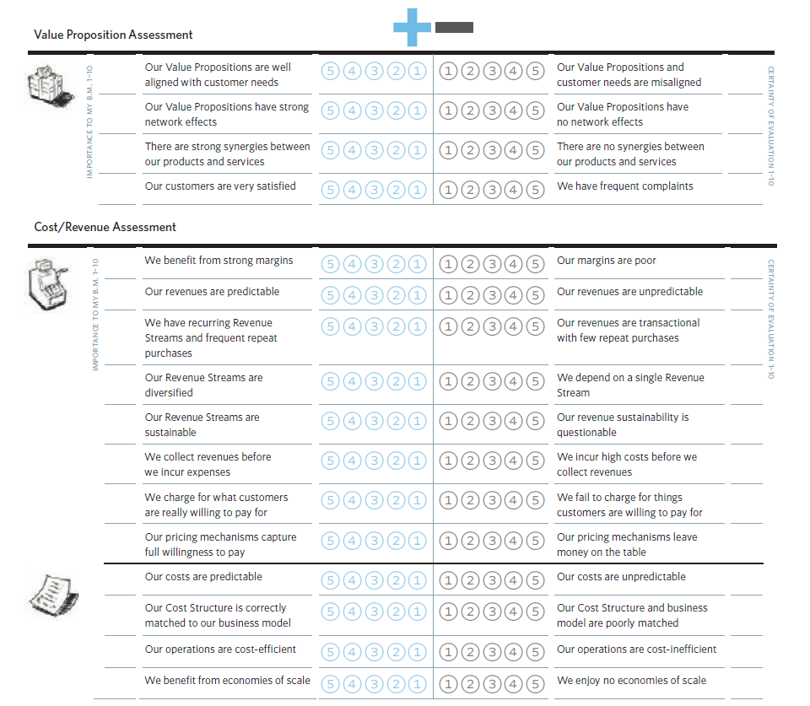
Page 216 -224

Slide 12
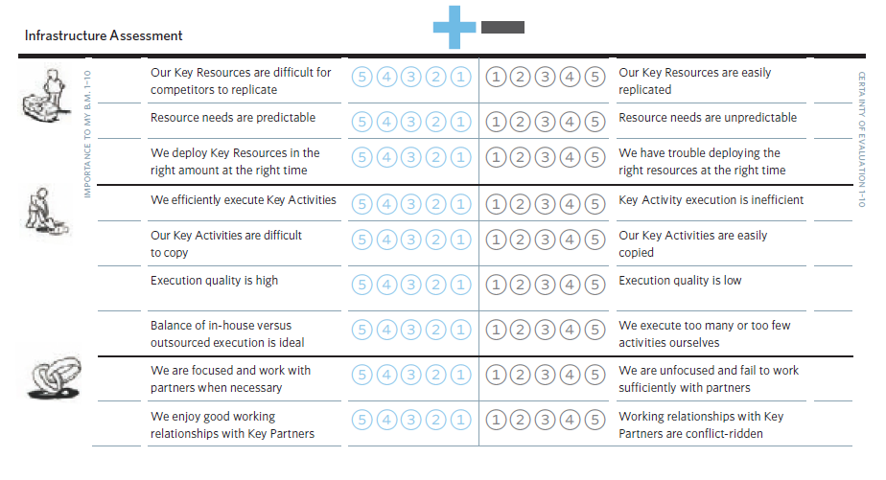

Slide 13
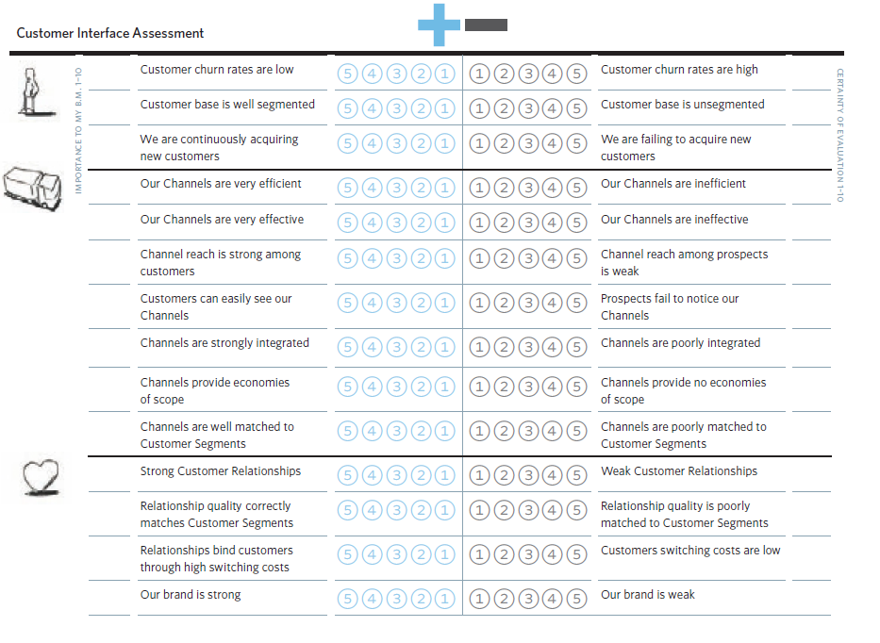

Slide 14
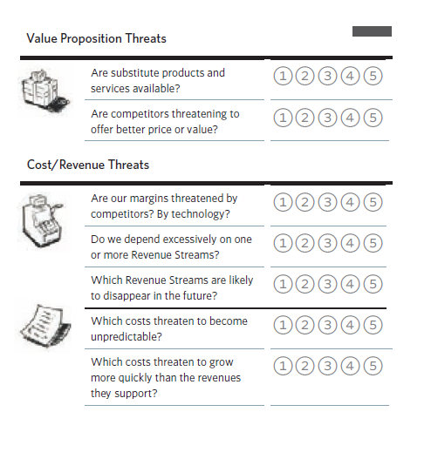
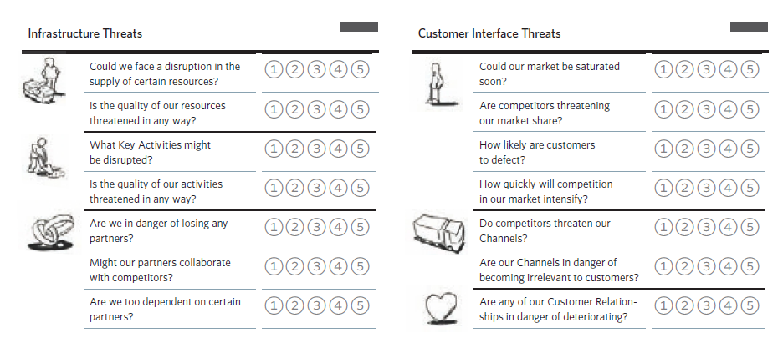

Slide 15
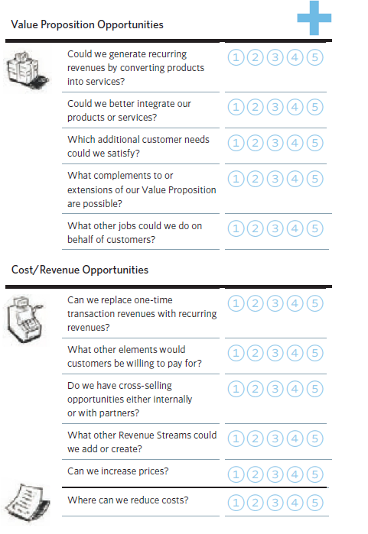
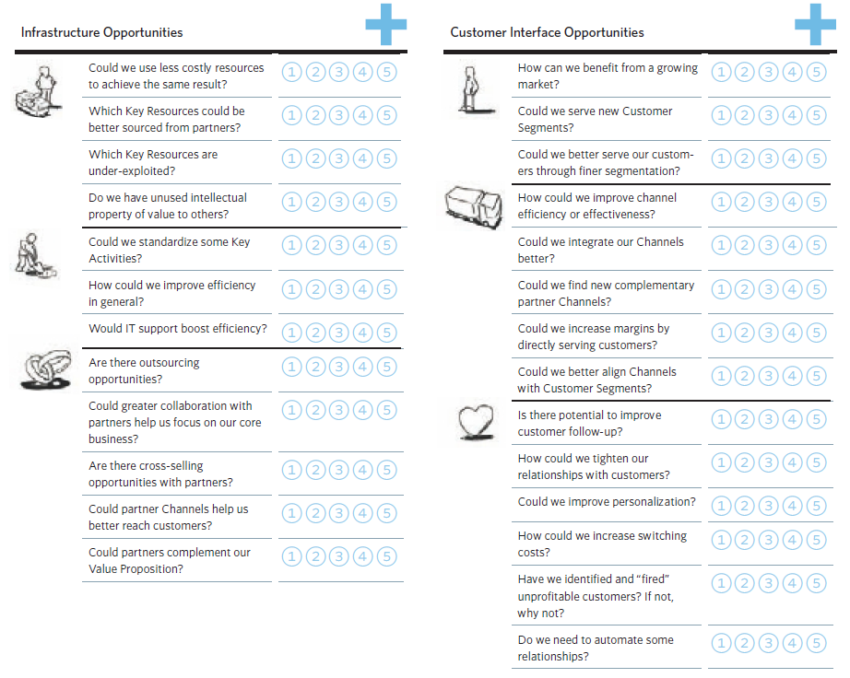

Slide 16
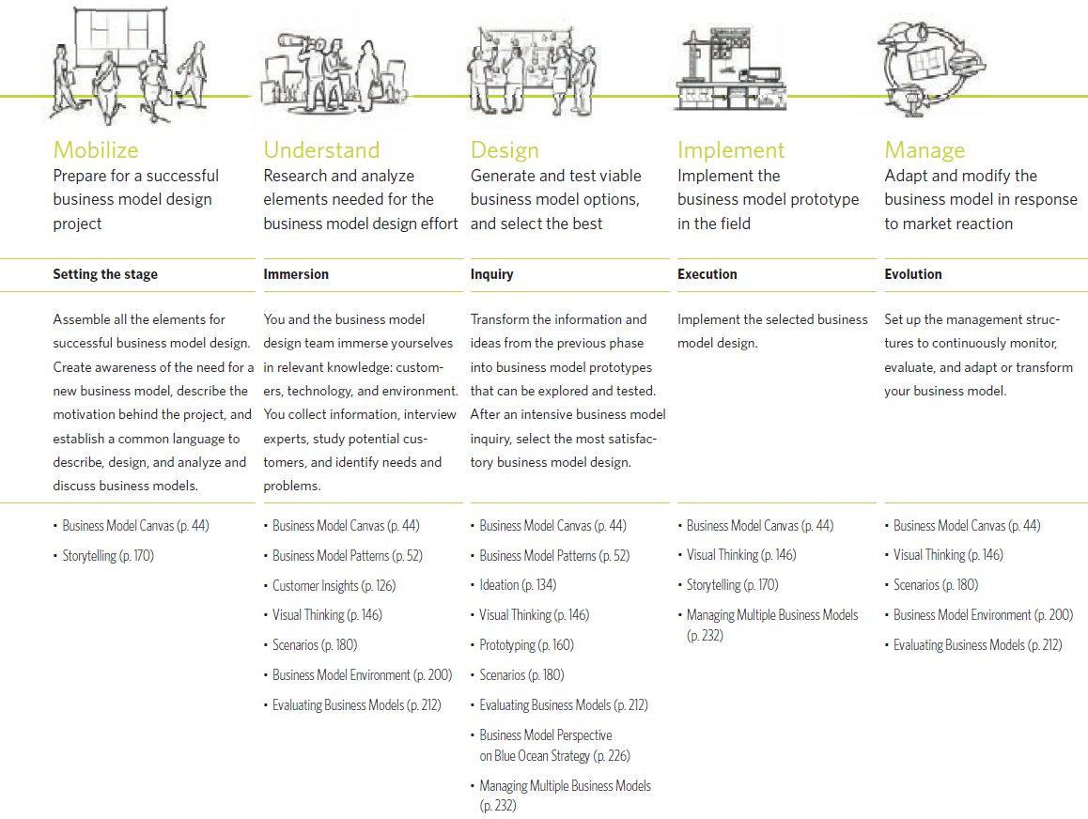
Page 249 - 259

Slide 17
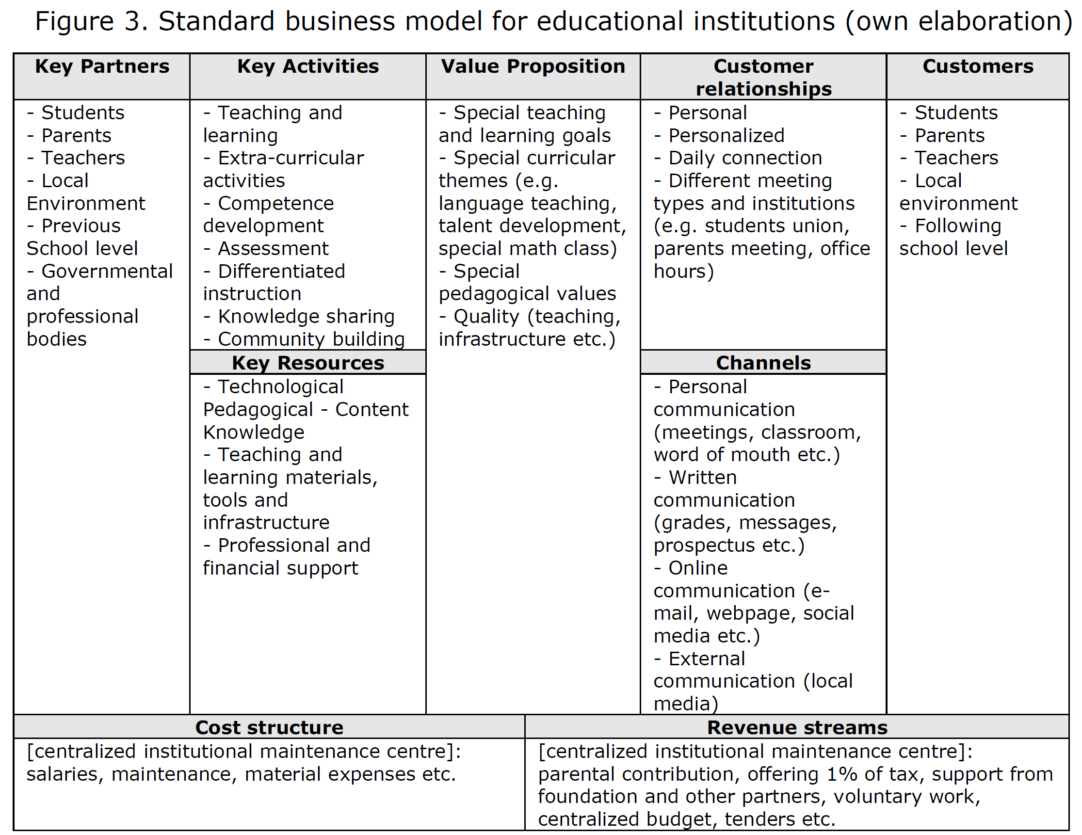

Slide 18
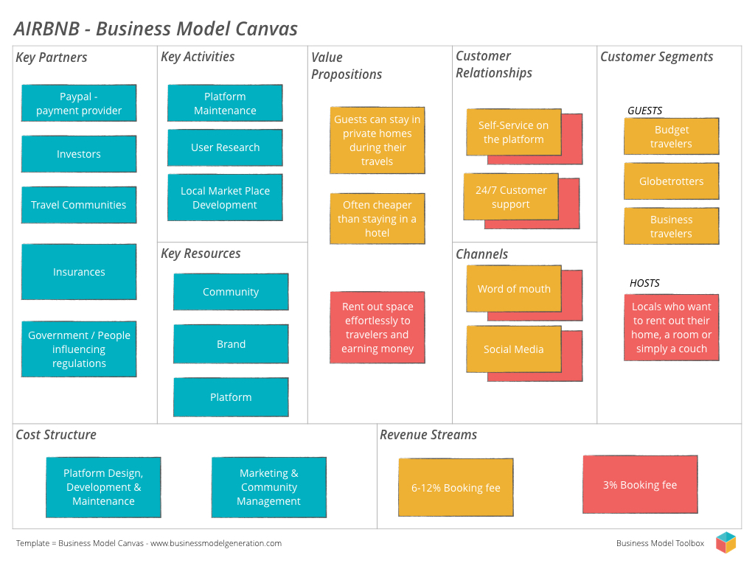

Slide 19
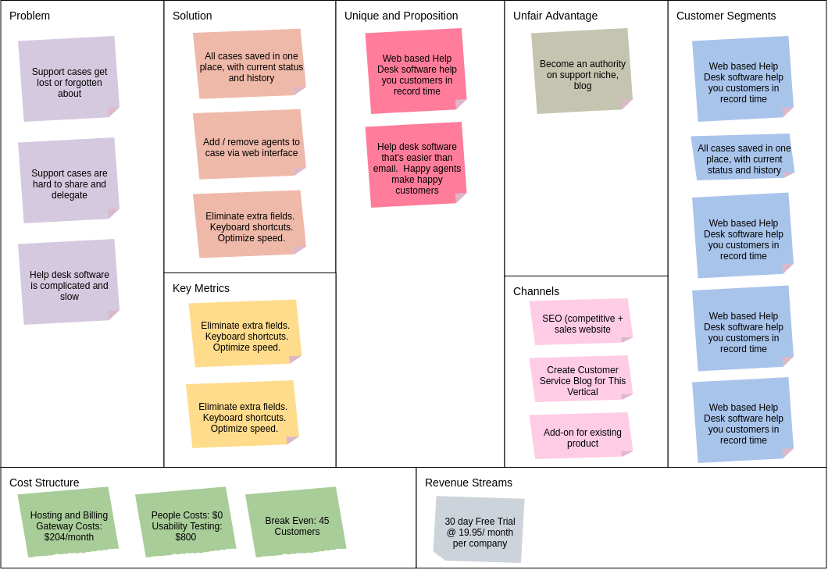
An example of a web hosting pro-vider using the Business Model Canvas to illu-strate their stra-tegic business plans.

Slide 20
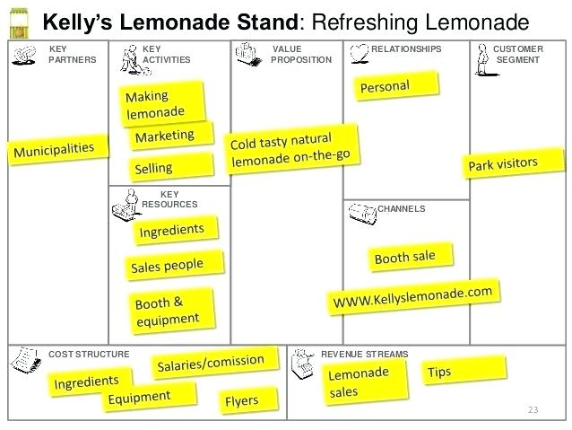

Slide 21
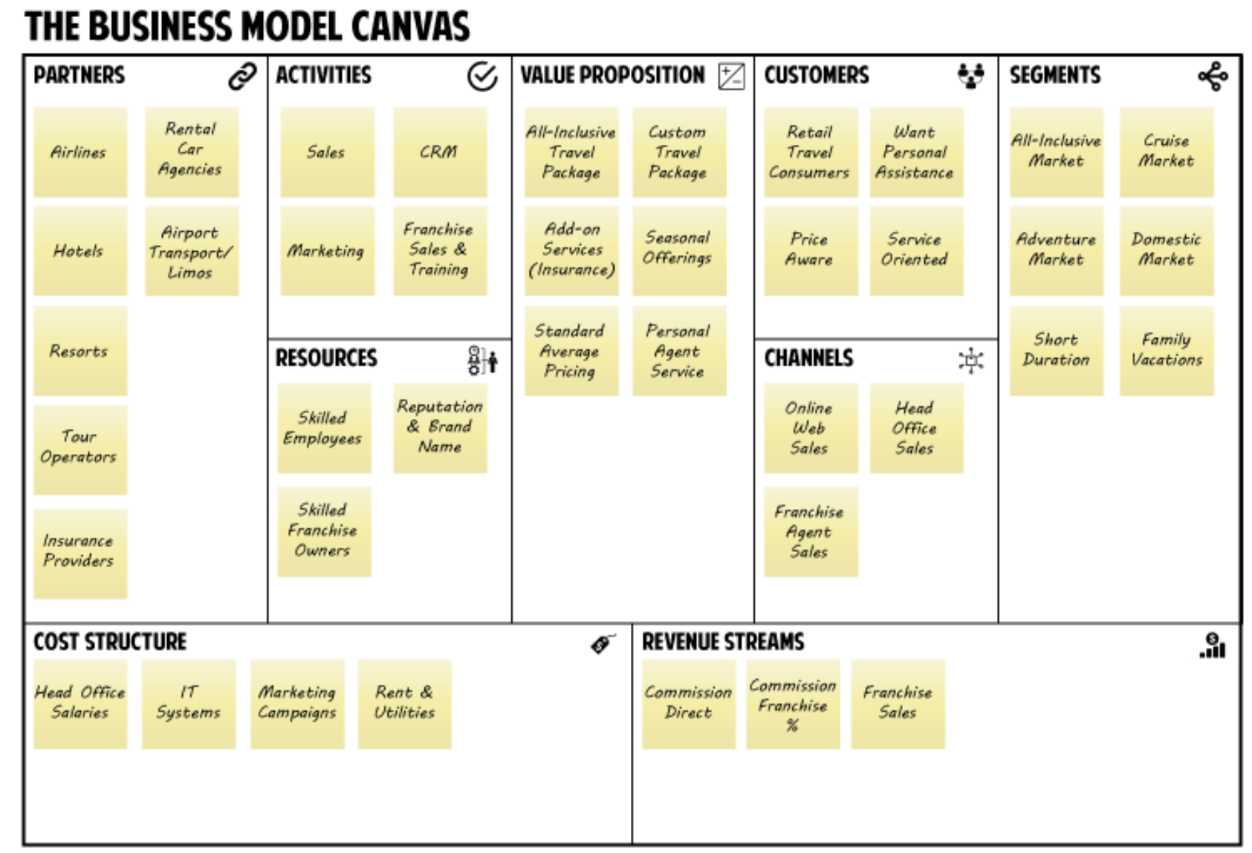
TRAVEL AGENCY – STRATEGIC BUSINESS MODEL
https://succeedsooner.ca/home-innovation-and-web-development-services-in-ontario/resources/case-studies/travel-agency-strategic-business-model/

